Slide 1
An Overview of the United Kingdom and the United states
Jenny

Slide 2
Orientation
Teaching Objectives
Teaching Content
Teaching Assessment

Slide 3
1. Teaching Objectives
To gain a comprehensive understanding of the geography, historical events, figures, and socio-political structures that have shaped British and American cultures.
To enhance students' ability to engage in informed discussions on cultural diversity, multiculturalism, and the challenges of cross-cultural communication.

Slide 4
1. Teaching Objectives
To enable students to critically analyze and compare the core cultural values, beliefs, and traditions that define British and American societies.
To explore the significant role of literature, the arts, and popular culture in shaping and reflecting cultural identities in both the UK and the US.

Slide 5
2. Teaching Content
1. Geography and History
2. The People and Their Culture
3. The government and Political Parties

Slide 6
3. Teaching Assessment
1) Class presence and participation---10%
2) Role-play&Video Making ---10%
3) After-class Reading---(5 times)---15%（灯塔阅读）
4) Writing assignments---15%（批改网）
5) Final in-class exercise---50%

Slide 7
3.1 Role-play Presentation Guidelines (the 8th Week)
Choose your favorite scene from a movie, TV show, drama, or musical to perform. The scene should be between 5 to 12 minutes long.
Groups of 2-5 people are encouraged. (If you'd prefer to perform alone, please inform me in advance.)
Everyone in the group must participate by speaking lines.
Your performance will be assessed based on pronunciation, intonation, emotional expression, and overall delivery.

Slide 8
3.2 Video Making Guidelines (the 14th Week)
Content: Introduce a famous Western philosopher, covering:
Biography
Key ideas, claims, and achievements
Strengths and weaknesses of their philosophy
How their ideas impact your life and attitudes
Format: Be creative! Ensure the video is clear, engaging, and informative.
(Turn to Next Page)

Slide 9
3.2 Video Making Guidelines:
Collaboration: Work as a team (3-4 members per group). Divide tasks, communicate effectively, and make sure everyone contributes.Every member must speak in English during the video to practice speaking skills.
Language: Use clear, correct English and present your ideas confidently.
Length: Aim for a 5-8 minute video to keep it concise and engaging.

Slide 10
Rules of Our Class
Speak English Freely: Don't be shy or afraid. Everyone is welcome to speak English in class. There will be no negative judgment, only support and encouragement for your efforts to communicate in English.
Immerse in the English - speaking Environment: Try to feel the English - speaking atmosphere and be yourself while learning and speaking English. Let English become a natural part of your self - expression in this class.
Stay Actively Involved and Enjoy the Process: Participate actively in all class activities, whether it's group discussions, role - plays, or answering questions. Have fun while learning English, because a positive attitude is the key to effective language acquisition.

Slide 11
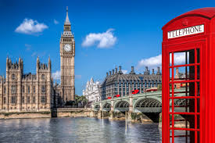
Warm-up
Speaking of the UK and British people, what comes to your mind?

Slide 12

Watch the video below and pick up a few interesting points and share with your partner!

Slide 13






Beijing University of Posts and Telecommunications
Unit 1 The Land of the U.K.

Slide 14
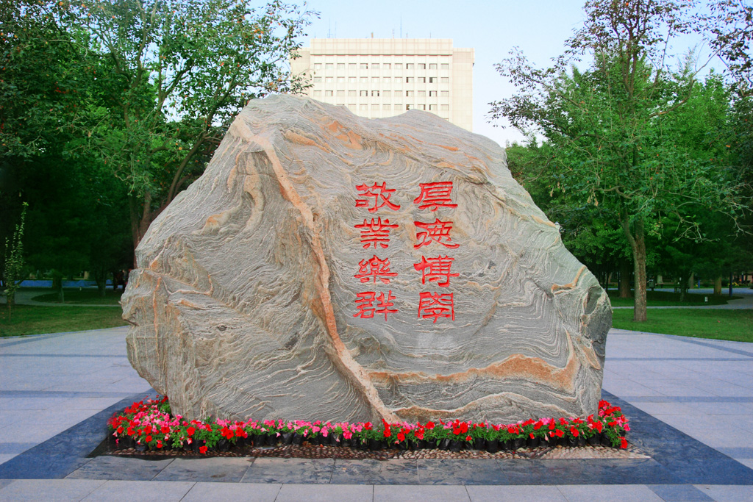

01
The Official Name，National Flag, National Anthem of the U.K.
The Location and Size of the U.K.
02
content
03
The Terrain, Rivers And Mountains of the U.K.
04
Major Cities and Scenic Spots in the U.K.

Slide 15

PART 01
The Official Name，National Flag， National Anthem of the U.K.

Slide 16
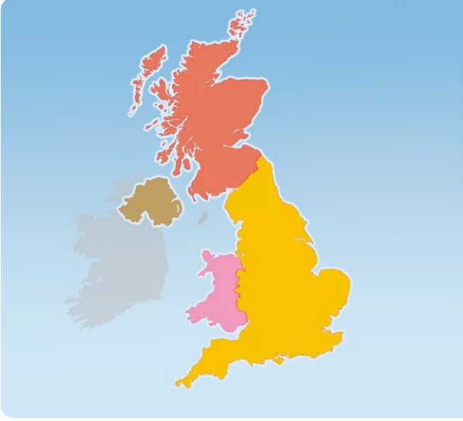
1. The Names
Britain
UK (The United Kingdom)
JUNE 18th

Slide 17
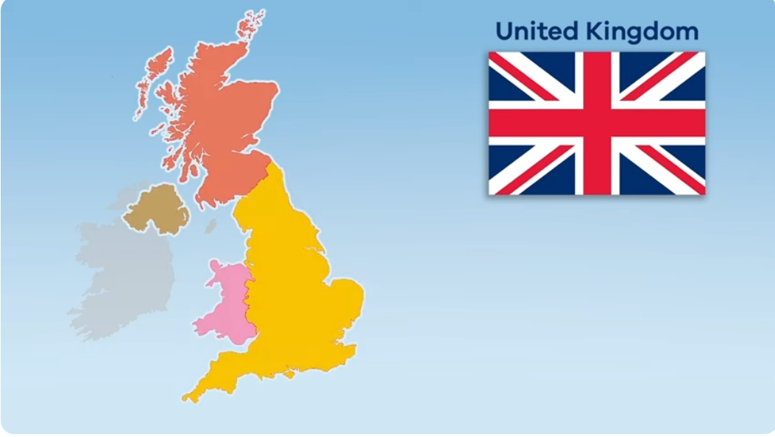
1. The Names
JUNE 18th

Slide 18
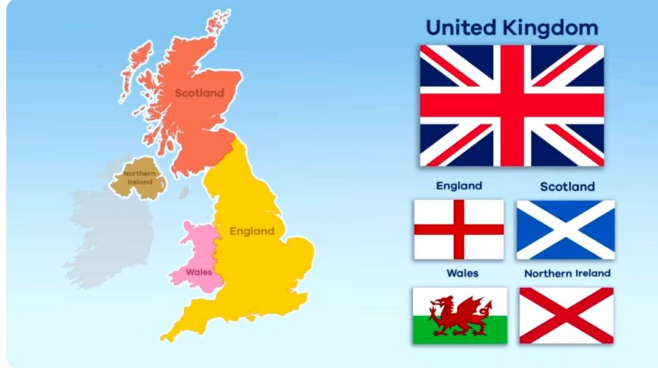
1. The Names
JUNE 18th

Slide 19
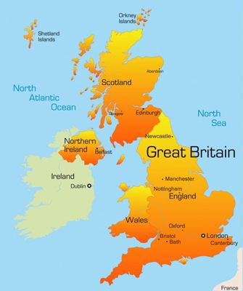
1. The Names
Great Britain (Geographical)
England, Wales, Scotland
The UK
The United Kingdom of Great Britain and Northern Ireland
JUNE 18th

Slide 20
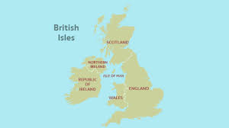
1. The Names
The British Isles is a geographical term that refers to a group of islands located off the northwestern coast of mainland Europe. It includes two main islands—Great Britain and Ireland—along with several smaller islands, such as the Isle of Man, the Channel Islands, and many others.
JUNE 18th

Slide 21
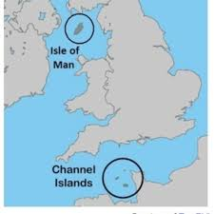
1. The Names
The Isle of Man and the Channel Islands are not part of the United Kingdom, but they are British Crown dependencies（皇冠属地）.
They have their own governments and legal systems, but they rely on the UK for some areas like defense and foreign relations.
JUNE 18th

Slide 22
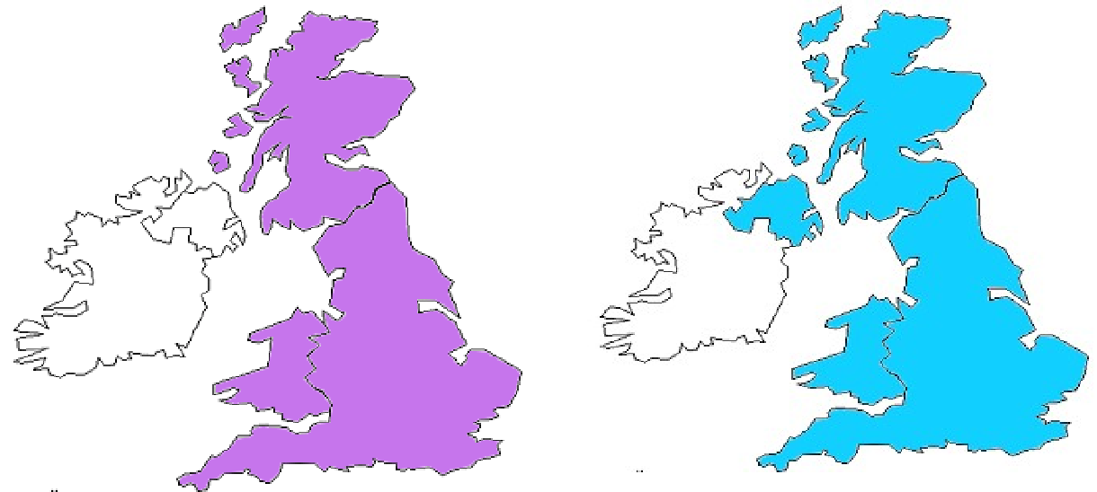
Q1:Is it ok to use “Great Britain” to refer to the UK? Why?
Great Britain
The United Kingdom
JUNE 18th

Slide 23
Q2: What’s the difference between “English people” and “British people”?
Great Britain
The United Kingdom
JUNE 18th

Slide 24
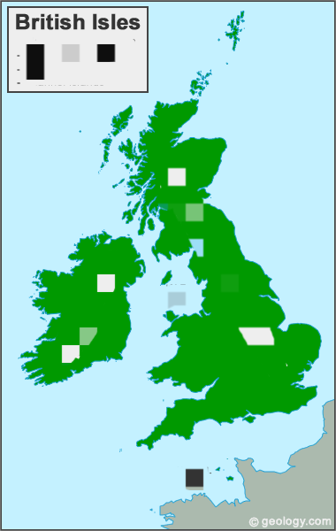
Q3: The British Isles includes two main islands: __________________
and___________ along with several smaller islands, such as,_________ the ____________, and many others

Slide 25
Q3: The British Isles includes two main islands:__Great Britain___
and__Ireland___along with several smaller islands, such as,_the Isle of Man_ and the Channel Islands_, and many others

Slide 26

2. The British National Emblem
JUNE 18th

Slide 27

2. The British National Emblem
Shield:
Each part represents one country of the UK.
Supporters: A lion and a unicorn
Crest: courage and strength.
Motto:
"Dieu et mon droit," which translates to "God and my right," signifying the divine right of the monarch to rule.
JUNE 18th

